Slide 1
Lecture # 04 Vector and Array Processor
Parallel and Distributed Computing
CS-482

Slide 2
Types of Array Processor
Array Processor performs computations on large array of data. These are two types of Array Processors: Attached Array Processor, and SIMD Array Processor. These are explained as following below.
1. Attached Array Processor :
2. SIMD array processor :

Slide 3
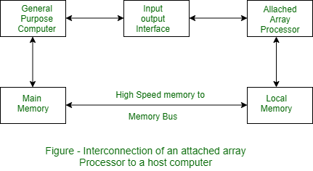
1. Attached Array Processor :
To improve the performance of the host computer in numerical computational tasks auxiliary processor is attached to it.

Slide 4
Attached array processor has two interfaces:
Input output interface to a common processor.
Interface with a local memory.
Here local memory interconnects main memory. Host computer is general purpose computer. Attached processor is back-end machine driven by the host computer.
The array processor is connected through an I/O controller to the computer & the computer treats it as an external interface.

Slide 5
Working:
Let us assume that we are executing vast number of instructions, in that case it is not possible to execute all instructions with the help of host computer. Sometimes it may take days of weeks to execute these vast number of introductions. So, in order to enhance the speed and performance of the host computer as shown in above diagram.
I/o interface is used to connect and resolve the difference between host and attached process. Attached array processor is normally used to enhance the performance of the host computer . Array processor mean bunch/group of process used together to perform any computation.

Slide 6
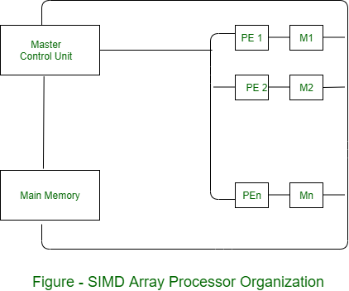
2. SIMD array processor :
This is computer with multiple process unit operating in parallel Both types of array processors, manipulate vectors but their internal organization is different.

Slide 7
SIMD array processor
SIMD is a computer with multiple processing units operating in parallel.
The processing units are synchronized to perform the same operation under the control of a common control unit. Thus, providing a single instruction stream, multiple data stream (SIMD) organization. As shown in figure, SIMD contains a set of identical processing elements (PES) each having a local memory M.

Slide 8
Working:
Here array processor is in built into the computer unlike in attached array processor where array processor is attached externally to the host computer. Initially mark control unit decodes the instruction and generate the control signals and passes it into all the processor elements(PE’s) or ALU upon receiving the control signals from master control unit, all the processing elements come to throw that operations need to perform. The data perform the operations will be accessed from main memory into the local memory of respective PE’s. SIMD array processor is normally used to compute vector data. All PE’s execute same instruction simultaneously on different data.
for ex: Ci= Ai + Bi
Here the vector instruction Ci= Ai+ Bi need to be executed is addition operation, the master control unit generate control signal and passes it onto all processing elements and data.

Slide 9
Working:
Parallelly on same instruction on with different data, that’s why it is called as Single instruction multiple data streams(SIMD) array processor.
Each PE includes –
ALU
Floating point arithmetic unit
Working registers

Slide 10
Working:
Master control unit controls the operation in the PEs. The function of master control unit is to decode the instruction and determine how the instruction to be executed. If the instruction is scalar or program control instruction then it is directly executed within the master control unit.
Main memory is used for storage of the program while each PE uses operands stored in its local memory.

Slide 11
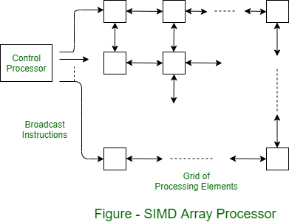
Operation of SIMD Array Processor
The SIMD form of parallel processing is called Array processing. Figure shows the array processor. A two-dimensional grid of processing elements transmits an instruction stream from a central control processor. As each instruction is transmitted, all elements execute it simultaneously. Each processing element is connected to its four nearest neighbors for the purposes of data exchange. Connections around the end can be provided on both rows and columns, but they are not shown in figure.

Slide 12
Vector processor classification
Vector processors have rightfully come into prominence when it comes to designing computing architecture by virtue of how they handle large datasets efficiently. A large portion of this efficiency is due to the retrieval from architectural configurations used in the implementation. Vector processors are classified into two primary architectures: memory to memory and register to register. These classification are important to optimize performance on the scientific computing and other data intensive applications.

Slide 13
What is Vector Processor Classification?
Vector processor classification is the labeling of processors based on the amount of vector operations it could be handling at a time. Here are the main classifications of vector processors:

Slide 14
Memory to Memory Architecture
In memory-to-memory architecture, source operands, intermediate results, and final results are retrieved directly from the main memory. For memory-to-memory vector instructions, it is necessary to specify the base address, offset, increment, and vector length to facilitate data transfers between the main memory and pipelines. Notable processors employing memory-to-memory formats include TI-ASC, CDC STAR-100, and Cyber-205.
Main points about Memory-to-Memory Architecture
No limitation on size.
Speed is comparatively slower.

Slide 15
Register to Register Architecture
In register-to-register architecture, operands and results are retrieved indirectly from the main memory through the use of a large number of vector or scalar registers. Processors like Cray-1 and Fujitsu VP-200 utilize vector instructions in register-to-register formats.
Main points about Register-to-Register Architecture
Limited size.
Higher speed compared to memory-to-memory architecture.
Increased hardware cost.

Slide 16
Hybrid Architecture
Hybrid Architecture unites memory-to-memory and register-to-register architectures to gain from all. The way is that of flexible operand retrieval methods; which improves performance and efficiency in many computational tasks. This solution provides a balanced solution which can be adapted to requirements of the application, with a better utilization of available resources.

Slide 17
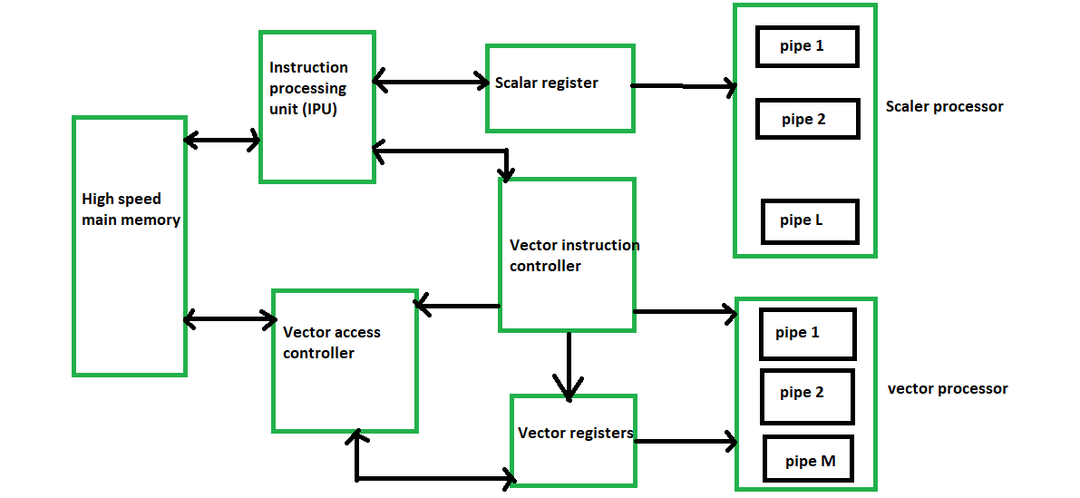
A block diagram of a modern multiple pipeline vector computer is shown below:

Slide 18
Advantages of Vector Processor
Parallelism and SIMD Execution: Vector processors are intended to perform Single Guidance, Different Information (SIMD) activities. This implies that a solitary guidance can work on numerous information components in equal, considering a huge speedup in errands that include monotonous procedure on enormous datasets. This parallelism is appropriate for logical recreations, reenactments of actual frameworks, signal handling, and different applications including weighty mathematical calculations.
Proficient Information Development: Vector processors are enhanced for moving information productively among memory and the computer chip registers. This is pivotal for execution, as memory access is much of the time a bottleneck in many registering errands. Vector processors commonly incorporate specific information development directions that can move information in huge lumps, limiting the effect of memory dormancy.
Diminished Guidance Above: With SIMD tasks, a solitary guidance can play out similar procedure on various information components. This lessens the above related with getting, unraveling, and executing individual directions, which is especially helpful for errands that include tedious computations.
Energy Proficiency: By executing procedure on various information components at the same time, vector processors can accomplish higher computational throughput while consuming generally less power contrasted with scalar processors playing out similar activities consecutively. This energy effectiveness is significant for superior execution registering (HPC) applications where power utilization is a worry.

Slide 19
Advantages of Vector Processor
Logical and Designing Applications: Vector processors succeed in logical and designing reproductions where complex numerical calculations are performed on huge datasets. Applications like weather conditions displaying, computational liquid elements, atomic elements reproductions, and picture handling can benefit altogether from the computational power and parallelism presented by vector processors.
Superior Execution for Cluster Activities: Some true applications include controlling exhibits or grids of information, for example, in information examination, AI, and illustrations handling. Vector processors can perform activities like expansion, increase, and other component wise procedure on whole clusters with a solitary guidance, significantly speeding up these undertakings.
Compiler Streamlining: Vector processors frequently expect code to be written with a certain goal in mind to make the most of their capacities. Compiler improvements can naturally change undeniable level code into vectorized guidelines, permitting software engineers to zero in on the algorithmic plan as opposed to low-even out advancements.
Memory Transmission capacity Usage: Vector processors can productively use memory transfer speed by streaming information from memory into vector registers and afterward performing calculations on those vectors. This can assist with alleviating the exhibition effect of memory bottlenecks.
Vector Length Adaptability: Some vector processors permit adaptability in the length of vector tasks, empowering software engineers to pick the proper vector length in light of the application’s necessities and the accessible equipment assets.

Slide 20
Disadvantages of Vector Processors
Complexity of Programming: Development of such codes is complex because optimizing code for vector processors generally requires specialized knowledge.
Cost: Vector processors are expensive, because they require special hardware.
Limited Applicability: Not all applications are good candidates for vector processing; there are tasks that are inherently sequential and cannot profitably be executed in parallel.

Slide 21
Limitations of Vector Processor
Speed Limitation: Vector processors are limited by the speed at which they can execute instructions.
Memory Limitation: Vector processors are limited by the amount of memory available for storing data.
Instruction Limitation: Vector processors can only execute certain instructions and often require instruction modifications for more complex tasks.
Cost Limitation: Vector processors are often more expensive than scalar processors due to their advanced technology.

Slide 22
Conclusion
Vector processors provide an important means of improving computational efficiency, for example, in applications where lots of math and big data abound. If developers understand their classifications and architectural configurations, then they can use their capabilities effectively to realize better performance in different computational tasks.

Slide 23
What is the Primary Advantage of Using Vector Processors?
Operations on large datasets at the same time, much faster than with regular processors, are what vector processors are good at, for use in scientific and engineering datasets.

Slide 24
How does memory-to-memory architecture differ from register-to-register architecture?
The difference in performance characteristics affects the architectures of memory to memory and register to register memory architecture in which data retrieval is done directly from main memory and to registers respectively.

Slide 25
Vector Processor vs Scalar Processor
A processor is an essential component of a computer system, responsible for carrying out instructions in order to facilitate various computer operations. Traditionally, processors have been either vector processors or scalar processors, both of which have their own unique set of benefits and drawbacks. Vector processors are designed to complete multiple data operations in one instruction and can provide higher performance than scalar processors. Conversely, scalar processors are designed to carry out one instruction at a time and are more efficient for certain types of operations. In this article, we will discuss the differences between vector processors and scalar processors and how they are used in modern computing.

Slide 26
Vector Processor
A vector processor is a type of processor that can process multiple data elements at once. It is capable of performing operations on a vector of data elements in parallel. Vector processors are particularly useful for tasks such as image and video processing, where large amounts of data need to be processed in parallel. Vector processors are also used in scientific computing, where they are used to accelerate the processing of complex algorithms.

Slide 27
Characteristics of Vector Processor
Vector Processors are designed to process multiple data elements in parallel, while Scalar Processors process one data element at a time.
Vector Processors can be more efficient, as they can complete a given task with fewer instructions than a Scalar Processor.
Vector Processors are more complex than Scalar Processors, and require more memory and power to operate.
Vector Processors are used for more demanding tasks, such as scientific calculations and 3D game rendering, while Scalar Processors are used for simpler tasks, such as basic calculations and web browsing.
Vector Processors are more suitable for data-intensive applications, while Scalar Processors are better suited for applications that require fewer calculations.
Vector Processors can be more expensive than Scalar Processors, as they require more complex hardware and software.

Slide 28
Applications of Vector Processor
Computer-Aided Design (CAD): CAD software allows for the creation of realistic 3D models, which can be used for product design, engineering, and architecture. Vector processor power makes it easier to manipulate complex models and make changes quickly.
Image Processing: Vector processors are used to manipulating and analyzing images. This can include tasks such as edge detection, object recognition, and facial recognition.
Virtual Reality: Vector processors are used to rendering realistic 3D graphics in virtual reality applications. This allows users to experience a more immersive experience when interacting with virtual worlds.
Scientific Computing: Vector processors are used to performing complex calculations in scientific computing applications. This can include tasks such as calculating weather patterns or complex simulations.
Artificial Intelligence: Vector processors are used to helping train and run neural networks for artificial intelligence applications. This can include tasks such as facial recognition, object recognition, and natural language processing.
Data Analysis: Vector processors are used to analyzing large amounts of data quickly. This can include tasks such as analyzing customer data or financial data.

Slide 29
Scalar Processor
A scalar processor is a type of processor that can process one data element at a time. Scalar processors are typically used for general-purpose computing tasks, such as word processing and spreadsheets. Compared to vector processors, scalar processors are less powerful and slower, but they are cheaper and more energy-efficient.

Slide 30
Characteristics of Scalar Processor
Scalar processors deliver high-performance capabilities, capable of executing multiple instructions simultaneously.
Scalar processors execute a single instruction in one clock cycle.
Scalar processors are relatively low-cost compared to other types of processors.
Scalar processors have low power consumption, making them more efficient and cost-effective.
Scalar processors are highly flexible and can be used to solve a variety of problems.
Scalar processors are relatively simple in design and are easy to program and maintain.

Slide 31
Advantages of Scalar Processor
Low Cost: Scalar processors are typically much cheaper than vector processors, making them more accessible to many people.
Low Power Consumption: Scalar processors are much more efficient than vector processors, reducing the amount of power needed to operate them.
Easier to Program: Scalar processors are simpler to program than vector processors, making them easier to use for novice programmers.
Flexible: Scalar processors are more flexible than vector processors, allowing them to be used in a variety of applications.
High Clock Speed: Scalar processors are able to process instructions at a much faster rate than vector processors, increasing the speed of computations.
Good for Single-Threaded Tasks: Scalar processors are better suited for single-threaded tasks, as they can process one operation at a time.

Slide 32
Limitations of Scalar Processor
Memory Bandwidth: Scalar processors are limited by the amount of memory bandwidth available.
Instruction Set: Scalar processors typically have limited instruction sets and lack features found in modern processors.
Performance: Scalar processors are often limited in their performance due to their single-instruction execution.
Compatibility: Scalar processors are often limited in their compatibility with vector processors due to their different instruction sets.
Processing Speed: Scalar processors are typically slower than vector processors.

Slide 33
Applications of Scalar Processor
Video Games: Scalar processors are used to rendering 3D graphics for video games. This allows for faster and more realistic graphics, which can enhance the gaming experience.
Web Browsing: Scalar processors are used to rendering webpages quickly and accurately. This allows for a smoother and faster browsing experience.
Office Applications: Scalar processors are used to rendering documents and spreadsheets quickly. This allows for faster and more efficient document editing.
Graphics Applications: Scalar processors are used to rendering graphics quickly. This can include tasks such as image manipulation and video editing.
Database Applications: Scalar processors are used to quickly search and query large databases. This can include tasks such as customer data retrieval or financial data analysis.
Mobile Applications: Scalar processors are used to rendering graphics quickly for mobile applications. This allows for a smoother and faster user experience when interacting with mobile apps.

Slide 34
Vector Processor v/s Scalar Processor
Factor | Vector Processor | Scalar Processor
Architecture | It has a single instruction multiple data (SIMD) architecture. Instructions are executed multiple times in parallel on multiple data elements. | It has a single instruction single data (SISD) architecture. Instructions are executed one at a time on a single data element.
Execution Time: | It can execute instructions faster than a scalar processor due to the nature of SIMD architecture. | It takes more time to execute instructions since the instructions are executed one at a time.
Data Processing | It processes multiple data elements in parallel. | It processes single data element at a time.
Registers | It has multiple registers to store multiple data elements. | It has a single register to store a single data element.
Cache | It has multiple caches for multiple data elements. | It has a single cache for the single data element.
Branching | It does not support conditional vector branching. | It supports conditional vector branching.

Slide 35
Vector Processor v/s Scalar Processor
Factor | Vector Processor | Scalar Processor
Performance | It offers higher performance than a scalar processor due to its SIMD architecture. | It offers lower performance than vector processors due to its SISD architecture.
Power Consumption | It consumes more power than a scalar processor due to its more sophisticated architecture. | It consumes less power than a vector processor due to its simpler architecture.
Cost | It is more expensive than a scalar processor due to its sophisticated architecture. | It is cheaper than a vector processor due to its simpler architecture.
Parallelism | It has more parallelism due to multiple data elements being processed in parallel. | It has less parallelism due to a single data element being processed at a time.
Memory Bandwidth | It requires more memory bandwidth due to multiple memory accesses. | It requires less memory bandwidth due to single-memory access.

Slide 36
Vector Instruction Format in Vector Processors
Vector instruction format is a type of instruction format used in vector processors, which are specialized types of microprocessors that are designed to perform vector operations efficiently. In a vector processor, a single instruction can operate on multiple data elements in parallel, which can greatly accelerate certain types of computations, such as matrix multiplication, signal processing, and scientific simulations.
Vector instruction format is a type of instruction format used in vector processors, which are specialized processors designed to perform operations on vectors and matrices efficiently. In vector processors, a single instruction operates on multiple data elements in parallel, which is different from scalar processors where a single instruction operates on a single data element at a time.
The vector instruction format typically includes an opcode field that specifies the operation to be performed, a vector register specifier field that identifies the vector register that contains the data to be operated on, and a length field that specifies the number of elements in the vector.
The vector processor reads the vector instruction and retrieves the data from the vector register identified in the instruction. It then performs the specified operation on all the elements in the vector in parallel, and stores the result back into the same vector register or a different one, depending on the instruction.

Slide 37
Vector instruction formats can vary depending on the specific vector processor architecture, but they typically include some combination of the following fields:
Opcode field: specifies the operation to be performed on the vector data.
Vector register specifier field: identifies the vector register that contains the data to be operated on.
Length field: specifies the number of elements in the vector.
Mask field: specifies which elements in the vector to operate on.
Addressing mode field: specifies how to access the vector data in memory.
Data type field: specifies the data type of the elements in the vector.
Vector instruction formats allow vector processors to perform operations on large amounts of data in parallel, making them well-suited for scientific and technical applications, such as simulations, modeling, and image processing.

Slide 38
Vector instruction set
Different Instruction formats are used by different vector processors. Vector instructions are generally specified by some fields. The main fields that are used in vector instruction set are given below:
Operations Code (Opcode)
Base addresses

Slide 39
Operations Code (Opcode)
Operations Code (Opcode) – The operation code must be specified to select the functional unit or to reconfigure a multi-functional unit to perform the specified operation dictated by this field. Usually, microcode control is used to set up the required resources. For example: Opcode – 0001 mnemonic – ADD operation – add the content of memory to the content of accumulator Opcode – 0010 mnemonic – SUB operation – subtract the content of memory to the content of accumulator Opcode – 1111 mnemonic – HLT operation – stop processing

Slide 40
Base addresses: Key addressing components
Base addresses – For a memory reference instruction, the base addresses are needed for both source operands and result vectors. The designated vector registers must be specified in the instruction, if the operands and results are located in the vector register file, i.e., collection of registers. For example: ADD R1, R2. Here, R1 and R2 are the addresses of the register.
Offset (or Displacement) – This field is required to get the effective memory address of operand vector. The address offset relative to the base address should be specified. Using the base address and the offset (positive or negative), the effective address is calculated.
3. Address Increment – The address increment between the scalar elements of vector operand must be specified. Some computers, i.e., the increment is always 1. Some other computers, like TI-ASC, can have a variable increment, which offers higher flexibility in application. For example:
R1 <- 400
Auto incr-R1 is incremented the value of R1 by 1.
4. Vector length – The vector length (positive integer) is needed to determine the termination of a vector instruction.

